Slide 1
Leiderschap onder druk
Daan Stam

Slide 2
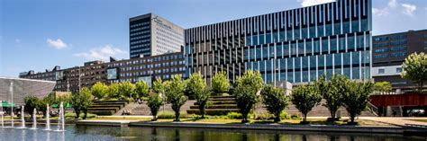

Slide 3
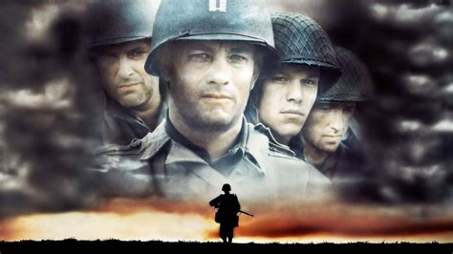
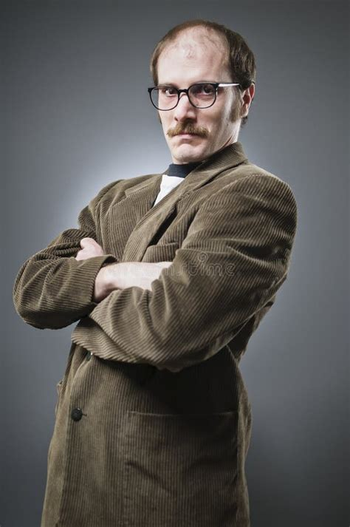
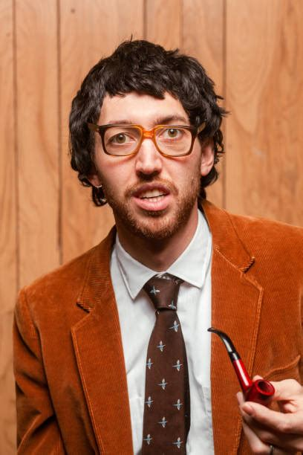
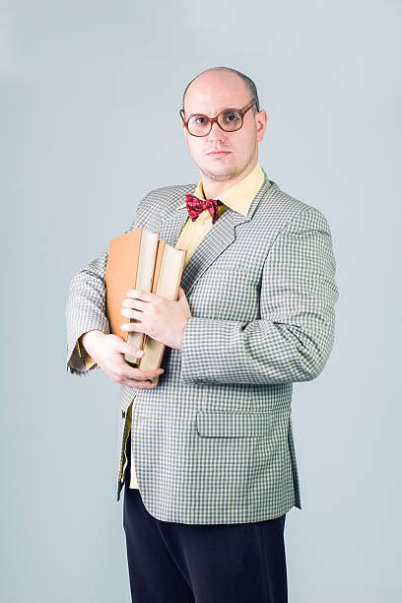
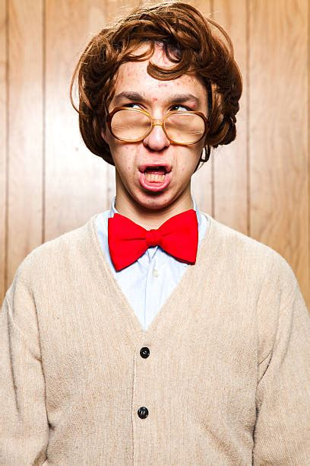

Slide 4
Principle of leadership – US marine corps
Know yourself and seek self-improvement.
Be technically and tactically proficient.
Know your people and look out for their welfare.
Keep your personnel informed.
Set the example.
Ensure the task is understood, supervised, accomplished.
Train your Marines (and Sailors) as a team.
Make sound and timely decisions.
Develop a sense of responsibility among your subordinates.
Employ your command within its capabilities.
Seek responsibilities and take responsibility.

Slide 5

Het bos door de bomen zien
inspirational
managerial process
empowering others
sensitivity
to member
needs
visionary
family-
supportive
envisioning
Charisma
Empowering
sustainable
paradoxical
unconventional behavior
delegative-
participative
consideration
Servant
Inspirational
Democratic
inspirational motivation
individualized
consideration
health-promoting
encouraging
collective learning
participative
supporting
collaborate
leader secure-base
support
organized
self-awareness
intellectual stimulation
entrepreneurial
political skills
Paternalistic
authentic
putting subordinates first
supportive
advocating change
humility
mgmt by
exception
(passive)
intellectual stimulation
political leadership
listening
networking
benevolent
consultative-advisory
authoritarian
autonomy-
supportive
responsible
boundary spanning
create
goal-focused
correcting
strength-based
encouraging innovation
problem-solving
strategic leadership
representing
challenge the process
planning
relational
transparency
spiritual
Inclusive
self-serving
recognizing
clarifying
distributive fairness
mgmt by exception (active)
coaching
Informational fairness
authoritative
Instrumental
personal reward
emotional
healing
procedural fairness
creating value for
the community
directive
external monitoring
interpersonal fairness
controlling
contingent reward
material reward
behavioral integrity
Responsible
self-sacrificing
balanced processing
conceptual skills
monitoring
operations
managerial rigidity
avoidance-orientation
compete
initiating structure
Ideological
bureaucratic
pragmatic
stewardship
leader character
moral manager
environmental sensitivity
moral person
Ethical
moral
behaving ethically
internalized moral perspective
Model the way
10

Slide 6
Het bos door de bomen zien
Ethiek
behavioral integrity
controlling
Responsible
managerial rigidity
avoidance-orientation
Ideological
bureaucratic
leader character
moral manager
stewardship
environmental sensitivity
moral person
Ethical
moral
behaving ethically
internalized moral perspective
Model the way
sensitivity
to member
needs
organized
political skills
family-
supportive
sustainable
Paternalistic
consideration
Servant
networking
political leadership
individualized
consideration
supporting
health-promoting
leader secure-base
support
correcting
authoritarian
goal-focused
collaborate
strategic leadership
representing
problem-solving
planning
putting subordinates first
supportive
self-serving
clarifying
benevolent
consultative-advisory
listening
Taak
recognizing
coaching
responsible
boundary spanning
Relatie
authoritative
Instrumental
mgmt by exception (active)
relational
transparency
spiritual
directive
external monitoring
personal reward
Inclusive
contingent reward
material reward
Informational fairness
distributive fairness
balanced processing
conceptual skills
monitoring
operations
emotional
healing
procedural fairness
creating value for
the community
compete
initiating structure
interpersonal fairness
self-sacrificing
pragmatic
inspirational
managerial process
empowering others
envisioning
visionary
Charisma
Empowering
paradoxical
unconventional behavior
delegative-
participative
inspirational motivation
Inspirational
Democratic
intellectual stimulation
encouraging
collective learning
participative
self-awareness
entrepreneurial
humility
authentic
intellectual stimulation
advocating change
mgmt by
exception
(passive)
create
strength-based
autonomy-
supportive
encouraging innovation
challenge the process
Innovatie
10

Slide 7

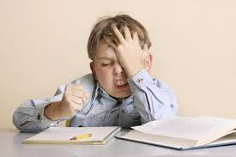


Vier basis psychologische behoeften
Incompetent
buitengesloten
Doeloos
Onveilig
Notes:
4 basic human needs

Slide 8
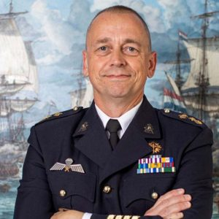
Het bos door de bomen zien
Ethiek
veilig
behavioral integrity
controlling
Responsible
managerial rigidity
avoidance-orientation
Ideological
bureaucratic
leader character
moral manager
stewardship
environmental sensitivity
moral person
Ethical
moral
behaving ethically
internalized moral perspective
Model the way
sensitivity
to member
needs
organized
political skills
family-
supportive
sustainable
Paternalistic
consideration
Servant
networking
political leadership
individualized
consideration
supporting
health-promoting
leader secure-base
support
correcting
authoritarian
goal-focused
collaborate
strategic leadership
representing
problem-solving
planning
putting subordinates first
supportive
self-serving
clarifying
benevolent
consultative-advisory
listening
Competent
Taak
recognizing
coaching
responsible
boundary spanning
Relatie
verbonden
authoritative
Instrumental
mgmt by exception (active)
relational
transparency
spiritual
directive
external monitoring
personal reward
Inclusive
contingent reward
Informational fairness
distributive fairness
conceptual skills
material reward
emotional
healing
procedural fairness
creating value for
the community
balanced processing
initiating structure
monitoring
operations
interpersonal fairness
compete
pragmatic
self-sacrificing
inspirational
managerial process
empowering others
envisioning
visionary
Charisma
Empowering
paradoxical
unconventional behavior
delegative-
participative
inspirational motivation
Inspirational
Democratic
encouraging
collective learning
participative
self-awareness
entrepreneurial
intellectual stimulation
humility
authentic
intellectual stimulation
advocating change
mgmt by
exception
(passive)
create
strength-based
autonomy-
supportive
encouraging innovation
challenge the process
Innovatie
betekenis
10

Slide 9
Principes en het kompas
Know yourself and seek self-improvement.
Be technically and tactically proficient.
Know your people and look out for their welfare.
Keep your personnel informed.
Set the example.
Ensure the task is understood, supervised, accomplished.
Train your Marines (and Sailors) as a team.
Make sound and timely decisions.
Develop a sense of responsibility among your subordinates.
Employ your command within its capabilities.
Seek responsibilities and take responsibility.

Slide 10
Principes en het kompas
Be technically and tactically proficient.
Ensure the task is understood, supervised, accomplished.
Make sound and timely decisions.
Employ your command within its capabilities.
Know your people and look out for their welfare.
Train your Marines (and Sailors) as a team.
Keep your personnel informed.
Set the example.
Seek responsibilities and take responsibility.
Develop a sense of responsibility among your subordinates.
Know yourself and seek self-improvement.
Taak
Relatie
Innovatie?
Ethiek

Slide 11
Methode
Interviews (anoniem ☺)
Thematisch coderen
Verder filosoferen

Slide 12
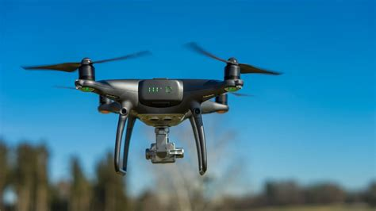
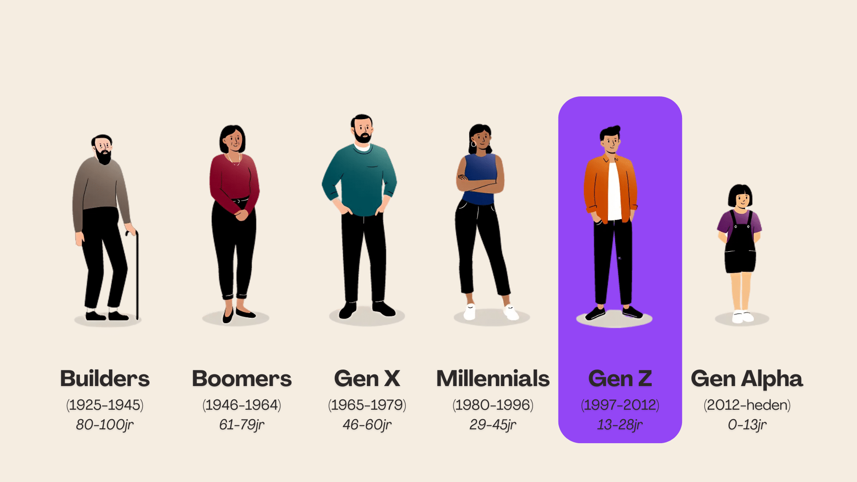
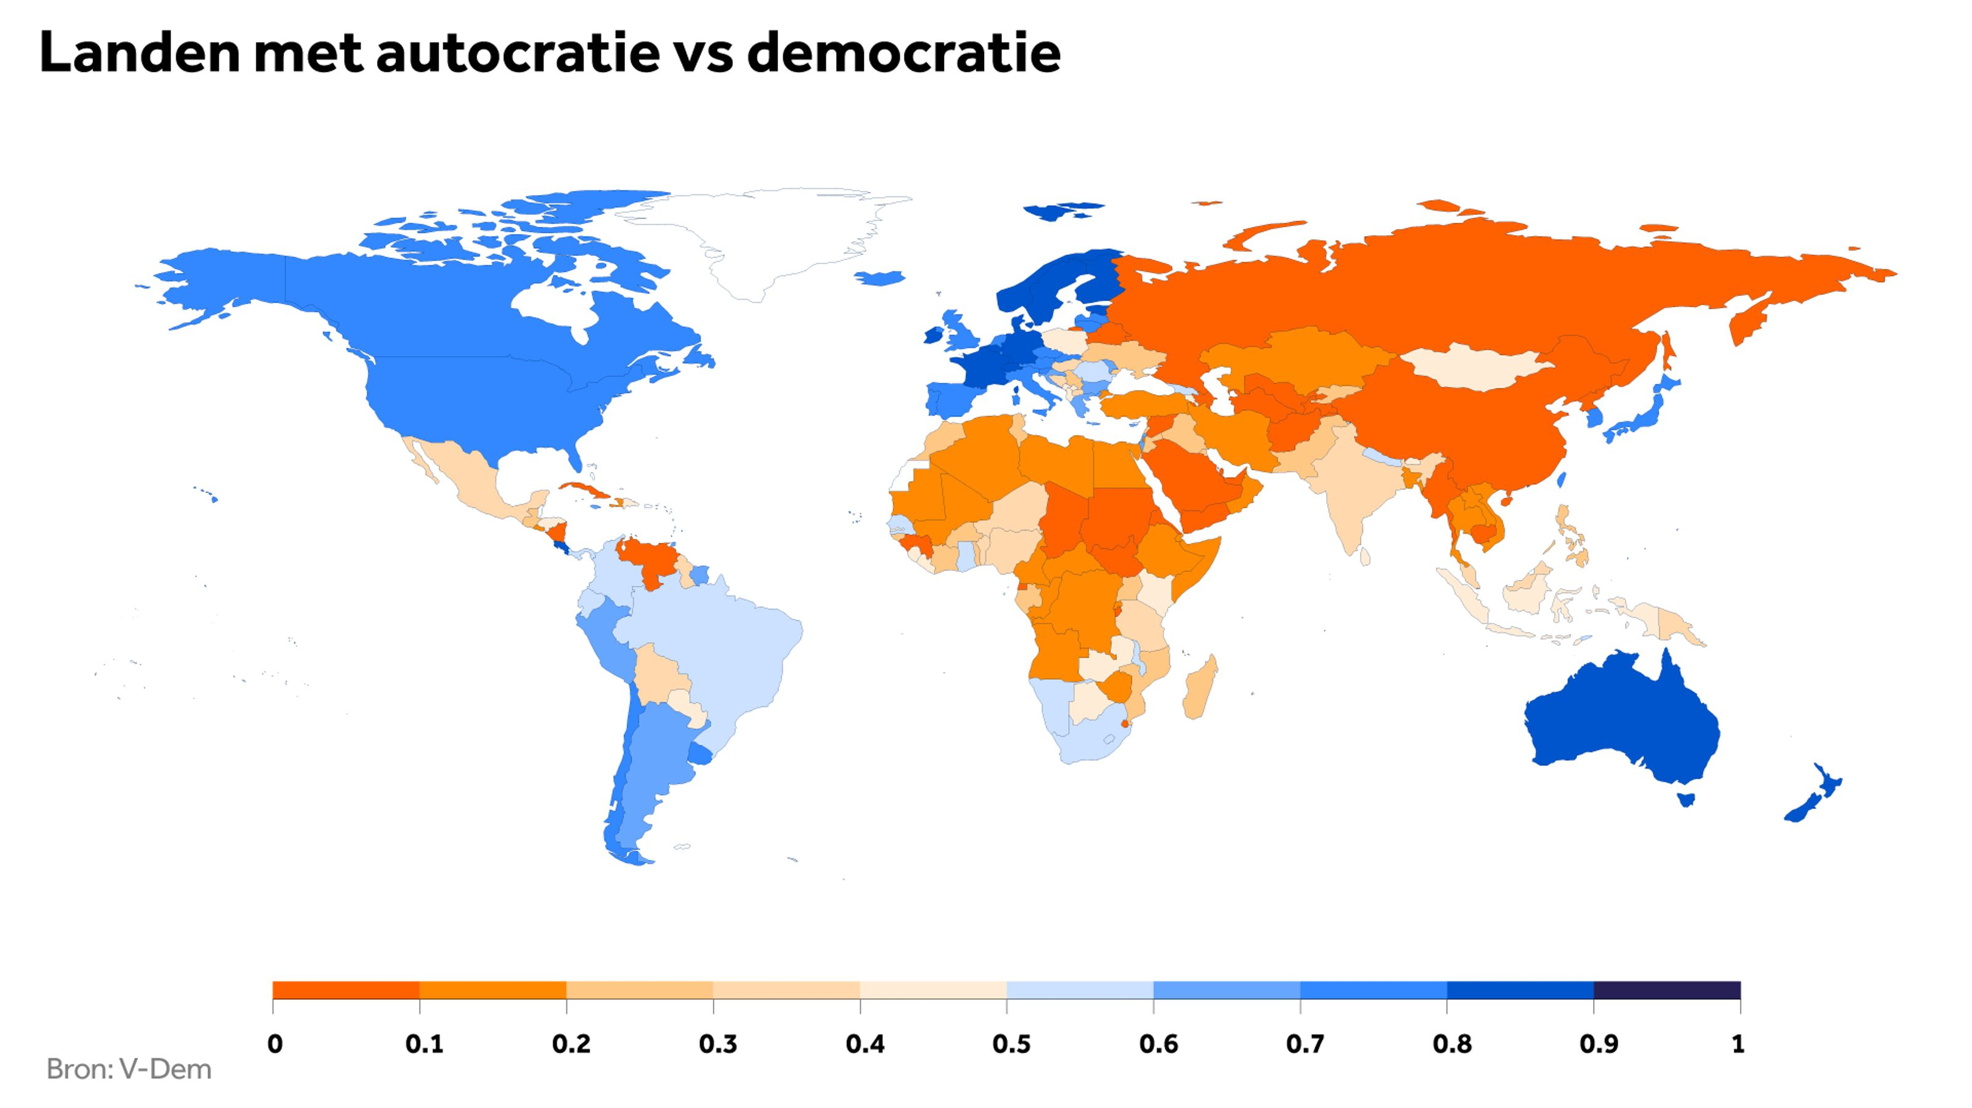
Grote trends
Technologie
Nieuwe generatie
Andere conflicten
Wereld politiek

Slide 13

1) Nieuw operationeel concept

Slide 14
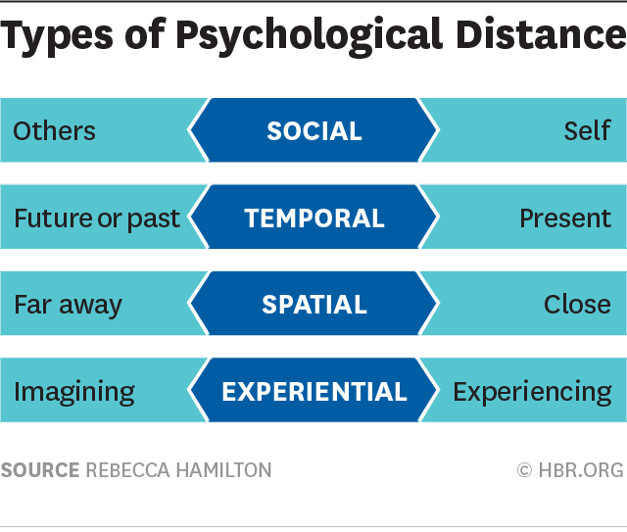
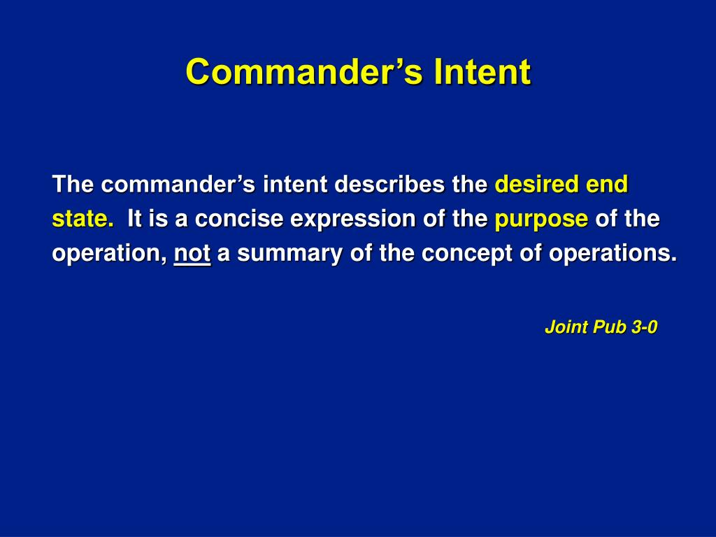
Psychologische afstand

Slide 15
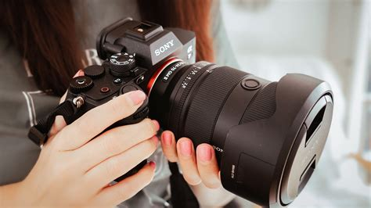
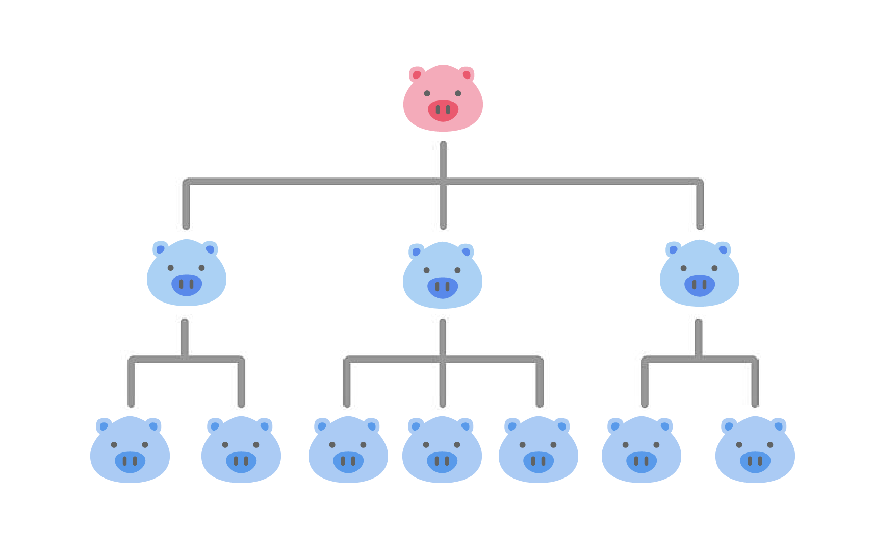
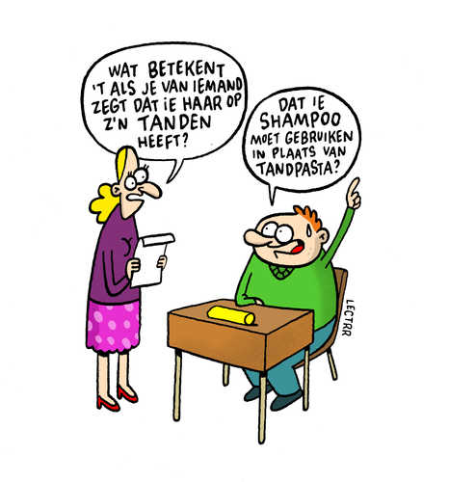
Visie: kapstok voor identiteit en overbruggen van afstand
All goals are equal but some goals are more equal than others
Abstract, long term, self-defining
Concrete, short term, get the job done

Slide 16
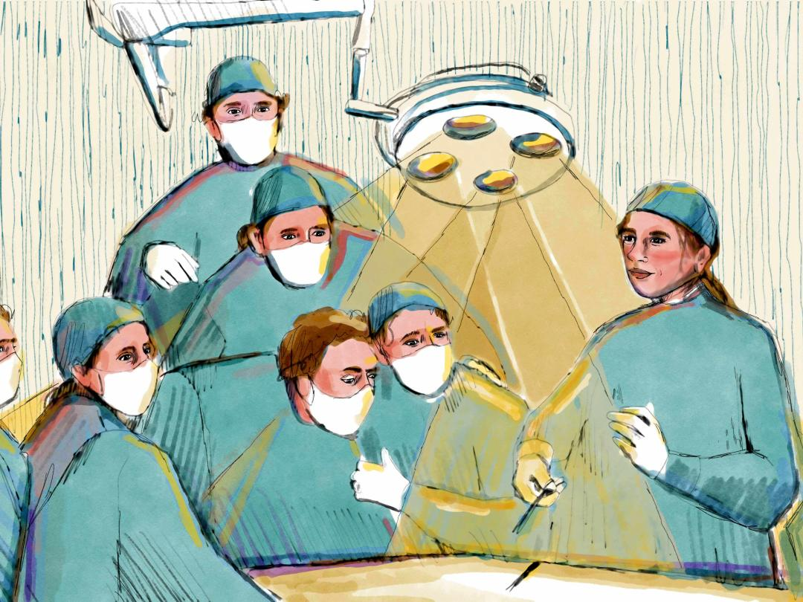
Kritisch meedenken en doen wat er wordt opgedragen

Slide 17

2) Innovatie en adaptiviteit

Slide 18
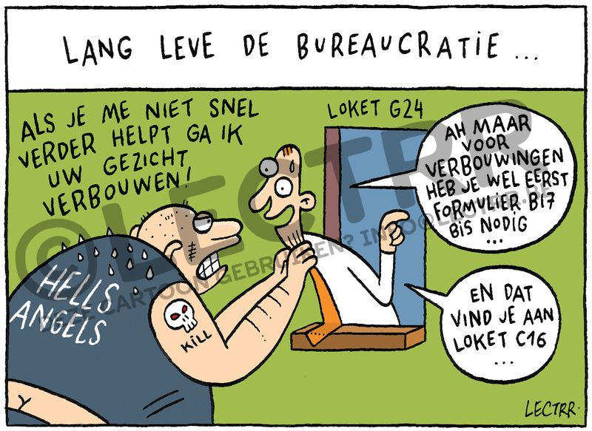
Bureacratie, centralizatie en de leider

Slide 19
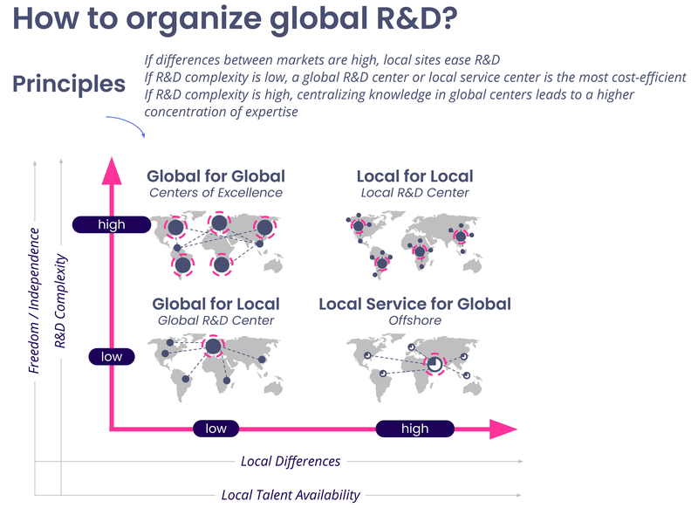
Locus van innovatie

Slide 20
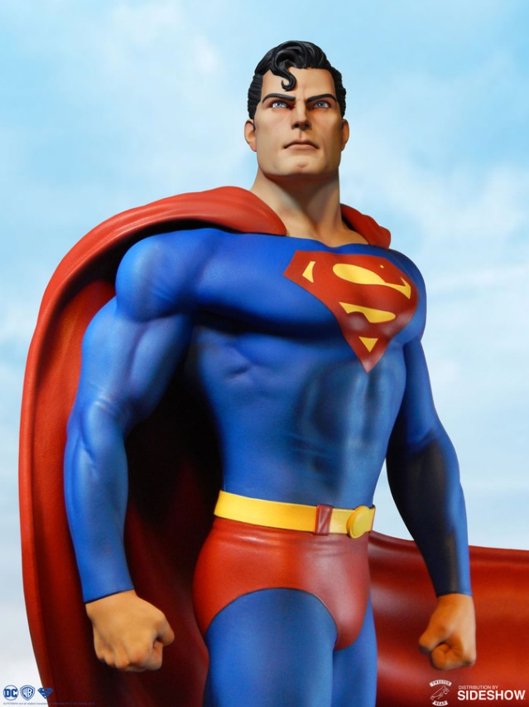

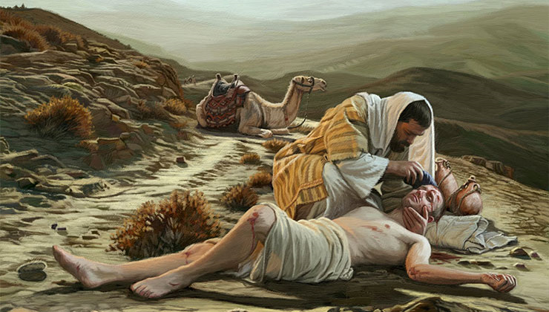
Bron van innovatie

Slide 21

3) Diversiteit

Slide 22
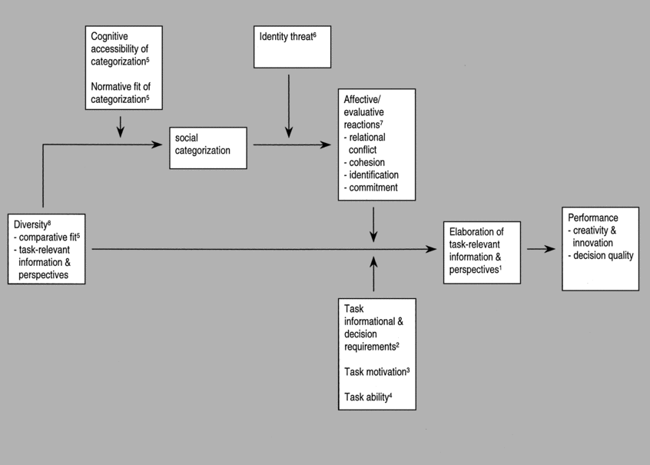
De effecten van diversiteit

Slide 23

De kern – respect!

Slide 24
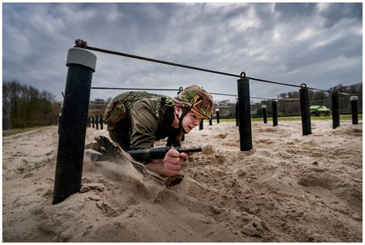

Opleiding en selectie

Slide 25


4) Rotaties

Slide 26
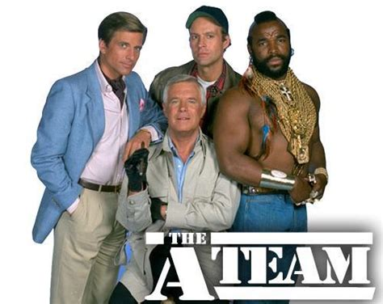

Modulariteit en standaardizatie

Slide 27

Leiders van binnen, leiders van buiten

Slide 28

De gevolgen van prestatie

Slide 29
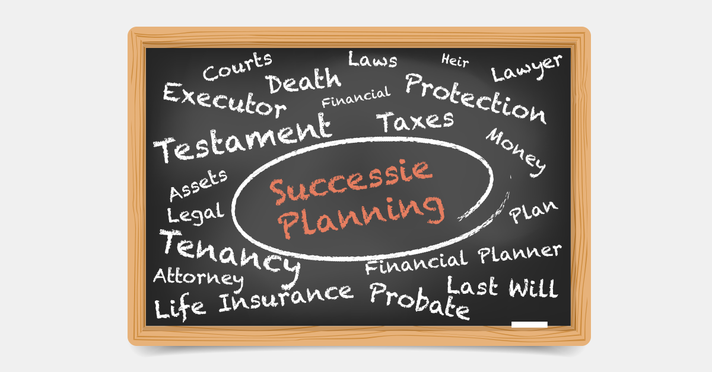
Het belang van succesieplanning

